Slide 1
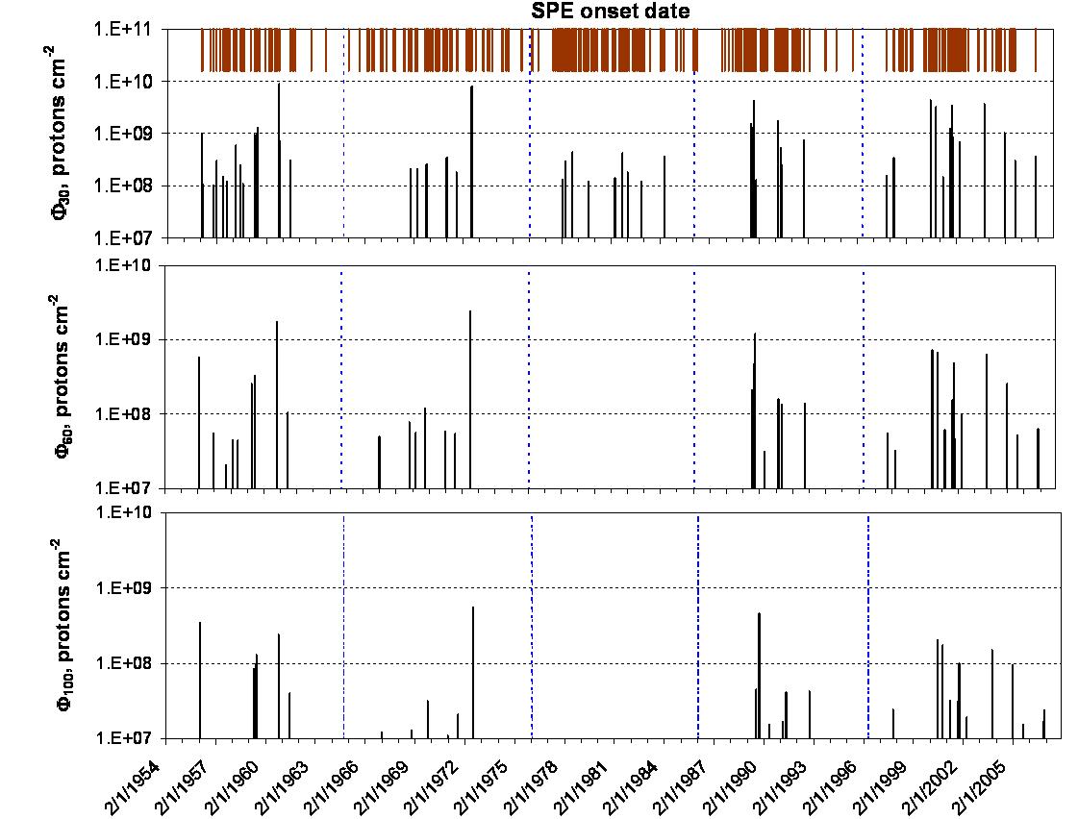
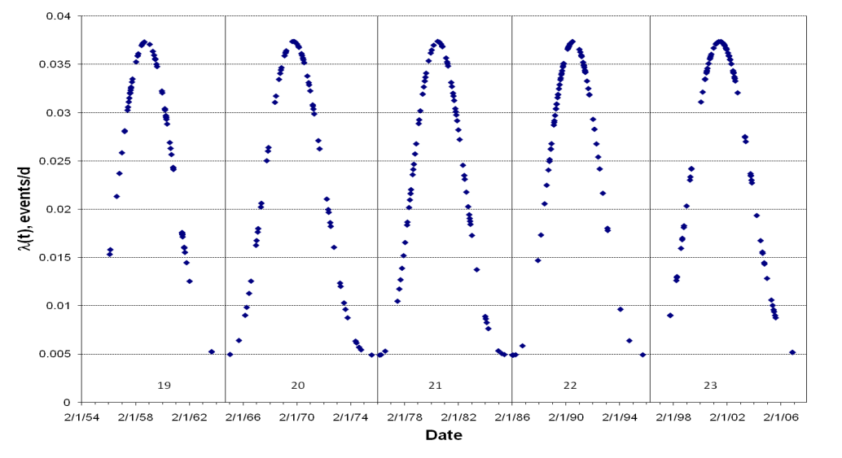
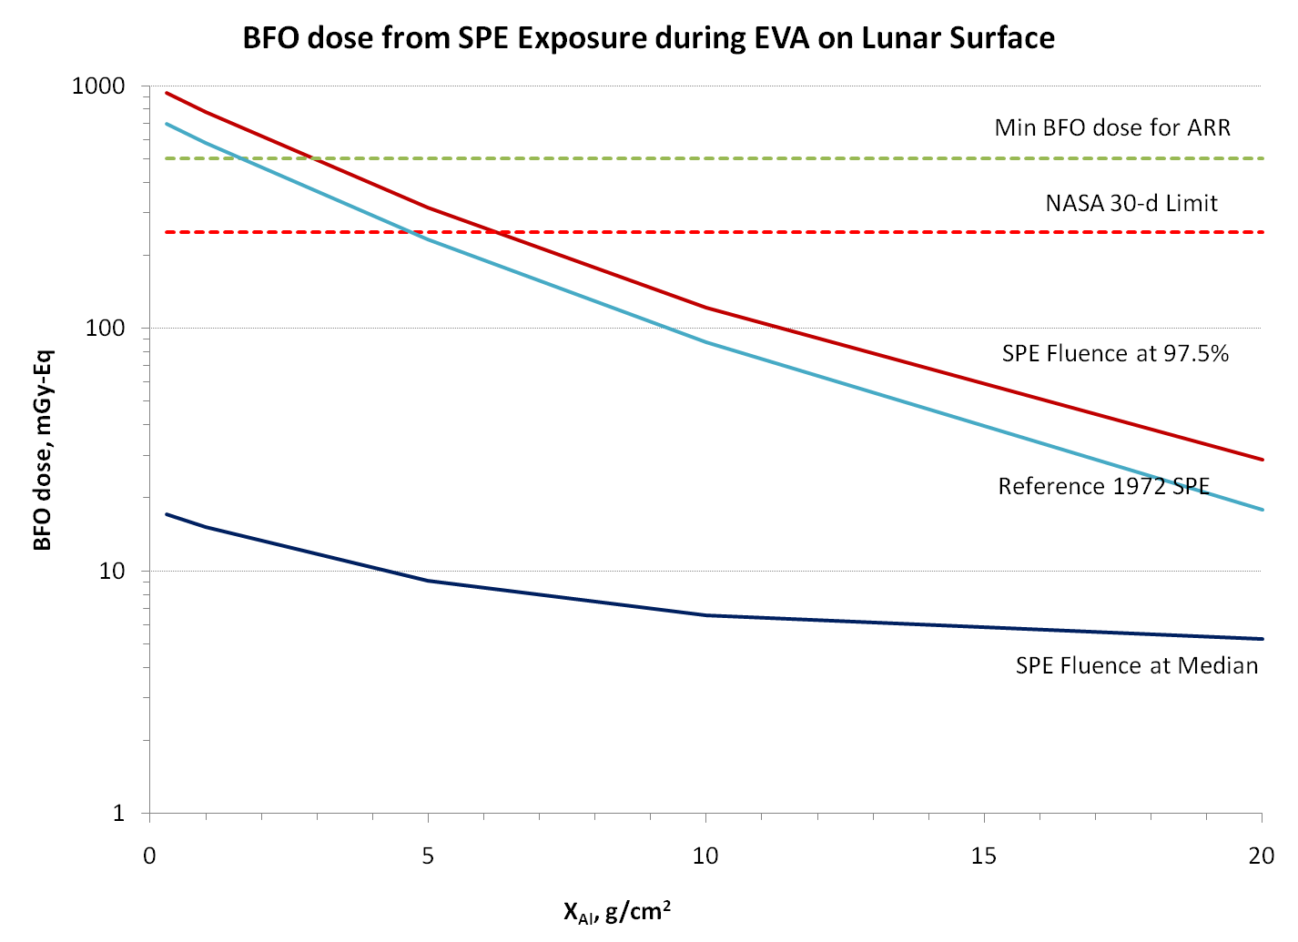
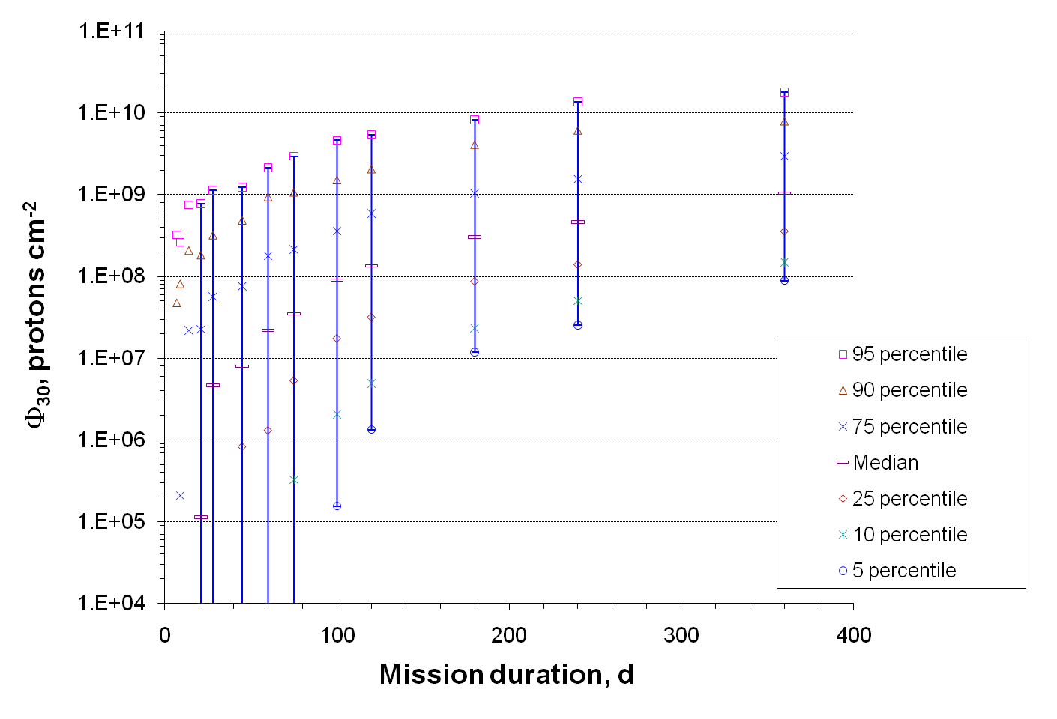
Model-based Prediction of SPE Frequency based on the Measurements of SPE Flux
and Organ Dose Analysis
Propensity of SPEs: Offset β Distribution Density Function

